Slide 1
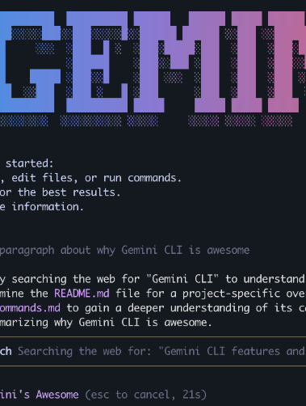

Gemini CLI
Concrete
Architecture
Group 3
Website: CISC 322 group 3 website
Video: A2 Video Presentation

Slide 2


Who did what?
Ming (group leader): overall planning and coordination, Understand dependency diagram, graphs making
Enrong (presenter): reflection analysis and concrete subsystem
Michael (presenter): concurrency, AI report
Omar: external interfaces, usecases
Nandun: subsystem architecture recovery and reflection analysis
Kosi: derivation process, intro, conclusion, abstract

Slide 3
Report Overview
Derivation Process
Changes on Conceptual Arch
Concrete Arch
Toolbox Conceptual & Concrete Arch
Use Case & Sequence Diagram
Reflexion Analysis
AI Collaboration
Lessons Learned
Limitations

Slide 4


Derivation Process
- Look back at A1 Conceptual and compare with global feedback
- Advices from Prof. Adams
- Modify our conceptual architecture diagram
- Use Understand to map folders/files to our conceptual components
- Focus more on layered style than client-server, or our alternative style: pub-sub
- Recover concrete architecture: iteratively drag and check folders/files

Slide 5
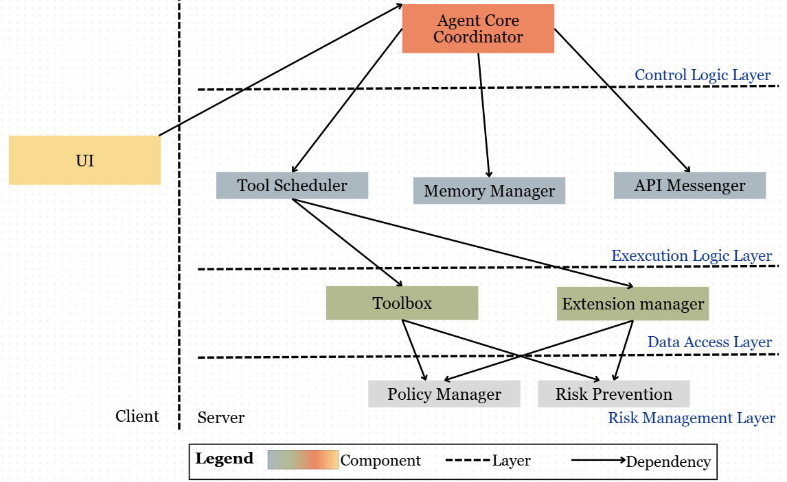
Original Conceptual Architecture

Slide 6
Orchestration Engine
Security & Execution
Task Delegation
System
Agent Core Coordinator
Tool Scheduler
Gemini API Messenger
Policy Manager
Risk Prevention Manager
Responsible for complex tasks
Contact point to Agent to Agent (A2A) Server
Configuration
System
Terminal
Changes on Conceptual Architecture
2 Merge | 2 Rename | 1 Create
Memory Manager
Keep track of configurations and GEMINI.md
User Interface (UI)
Exact same reponsibility as UI

Slide 7
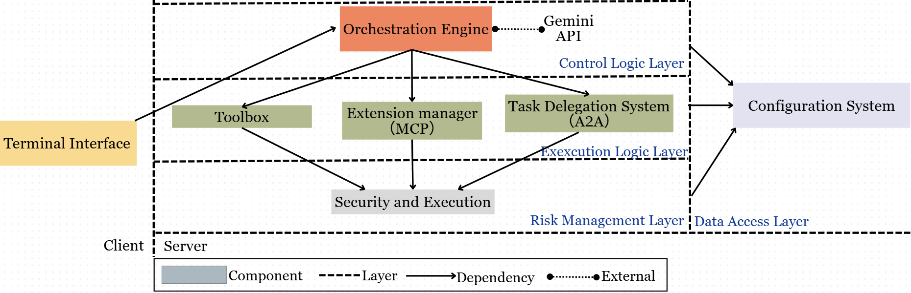
Modified Conceptual Architecture

Slide 8
Pipe and filter? No...
Terminal Interface
Orchestration Engine
Configuration System
Extension
Manager
Toolbox
Task Delegation
System
Security & Execution

Slide 9
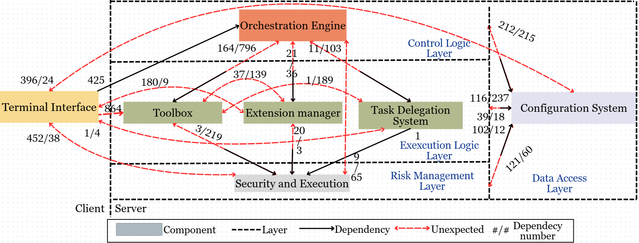
Concrete Architecture:

Slide 10

High-Level Reflexion Analysis
Terminal -> Toolbox (864)
Toolbox <-> Extension Manager (37/139)
- Import Tool types and Tool Registry interface
- Show tool list
- Render confirmation dialog and tool execution results
- Same layer but interact!
- MCP registered in Tool Registry
- More coupling between these two “parallel” components than we thought
Config System -> All Components
- Import types and interfaces from other components for initialization
- Not just passive data storage

Slide 11
Toolbox: Components
(same for conceptual & concrete)
Skills
Tools
- Evaluates the task and decide which tools are used by referencing to Tool Registry
- Orchestrates the execution process
- Handle complex task executions
- Give simpler tasks to Utils
Utilities (Utils)
Tool Registry
- Handle simple tasks
- Support Tools
- Hold information about all tools in Toolbox

Slide 12
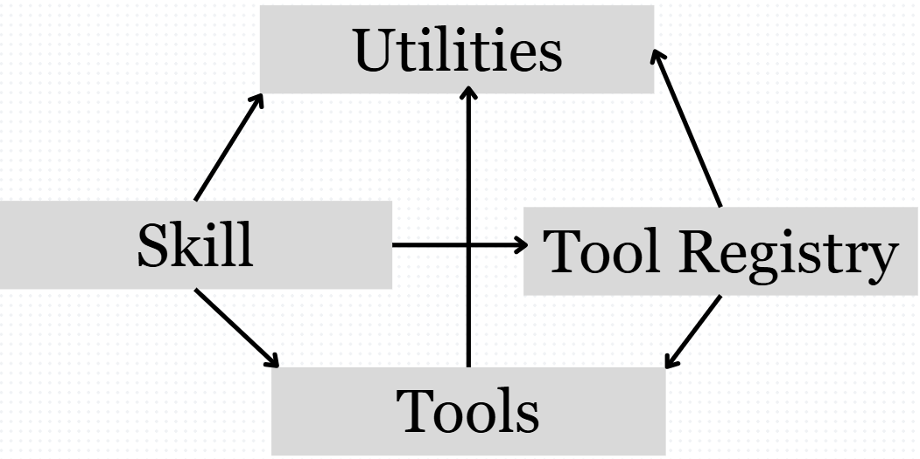
Toolbox Conceptual Architecture

Slide 13
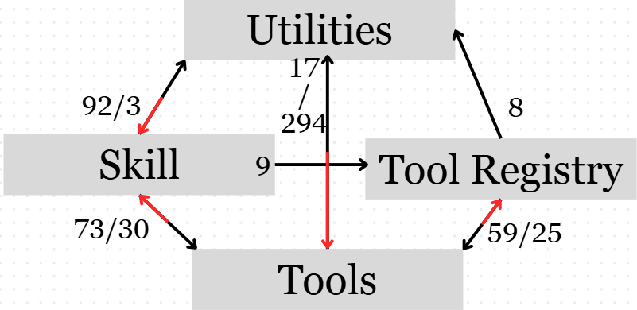
Toolbox Concrete Architecture

Slide 14
Toolbox Dependency
Divergences
Tools -> Tool Registry
Utils - > Tools
- activate-skill.ts queries the registry to list available tools when constructing skill context
- register themselves, query what else is available
- Import types and definitions
- workspaceContext.ts and toolCallContext.ts to provide context support for tool execution

Slide 15
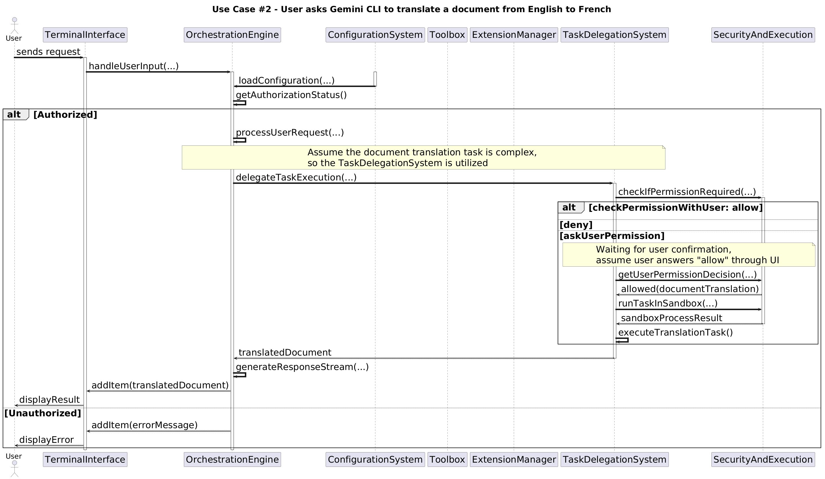
Use Cases: Translate File English to French

Slide 16
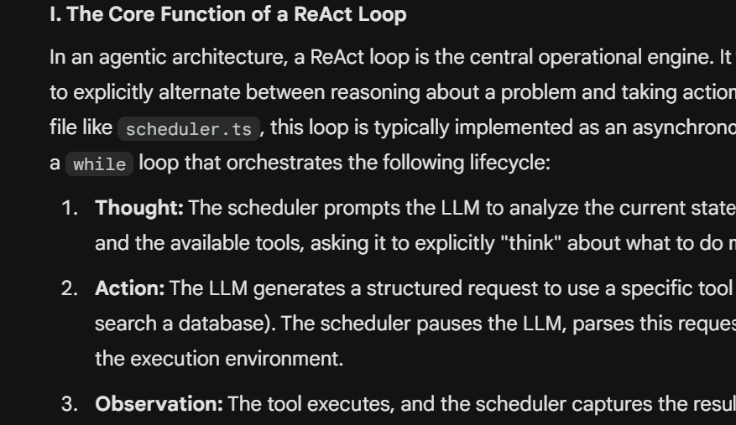
Prompt: (Few S)
Explain what the ReAct Loop does in packages/core/src/scheduler/scheduler.ts and how it's related to the seven subcomponents of our architecture.
Our AI Teammate: 8~10%
Keep the Same Strategy Using AI: Single Person & Refinement & BBBBBBBBBBbrainstorm Tool B
Scan CLI Codebase for Possible Dependencies | Human Verification
Check for Any Details We Could Have Missed

Slide 17
Lessons Learned
Non-parallelism of Working
Document Clearly
Concrete Architecture is not like Conceptual Architecture
One file assignment could shift entire dependency
Need to work out the critical step before everything else could continue
Gemini codebase not documented well
Time-consuming to discover commit & coding intents
Document our code for testing and debugging, and for future people reading it

Slide 18

- Overlooking Single Files
We only investigate large number dependencies in Understand simply by names of folder -> could overlook single file that does different job than rest of files in the folder
- Finer Grouping on Function Folder/files grouping does not extend to function level -> possible misinterpretation in dpendency
Limitations

Slide 19

if end: call(Thank You)

Slide 20

Credits
This presentation template is free for everyone to use, thanks to the following:
Pexels, Pixabay, Sketchify
for this presentation template
for the photos, graphics, and elements

